Slide 1
Text Classification

Slide 2

Problem Statement
Evaluation Metrics
The Data
Feature Engineering
Model Fitting & Selection
Final Model Performance
Model Interpretation

Slide 3
Problem statement
Our company wants to develop an NLP app that can distinguish between news and normal chat. For developing the app, train a classification model which will predict between subreddits WorldNews and CasualConversation for a given text.
audience
Data scientist colleague

Slide 4
Evaluation Metrics
Precisian-Recall AUC
Our company cares more on predicting WorldNews (target)
Hence, we will be using PR-AUC metrics to select best model.
Baseline
Our baseline is 46% PR AUC score, our model at minimum must perform better than the baseline.

Slide 5
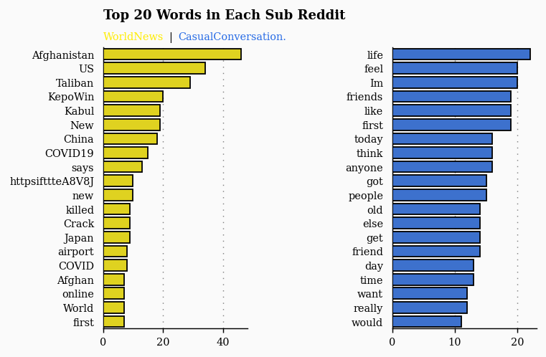
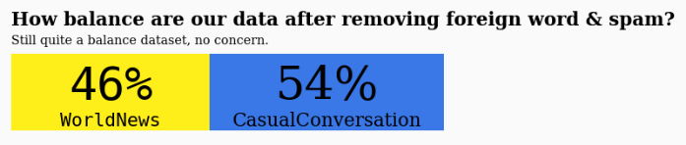
The Data

Slide 6
Feature Engineering
Count Vectorizer
Tf-idf Vectorizer
Pre-trained Word2vec (By Google on 2013)

Slide 7
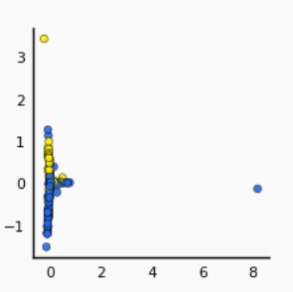
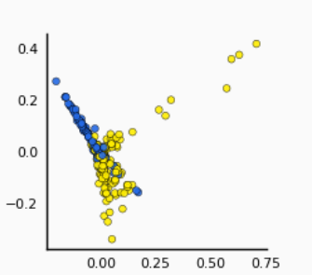
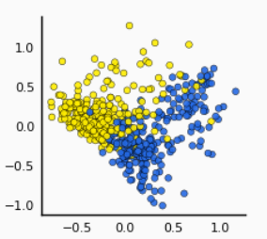
Pre-Processing
Pca Visualization
Count Vectorizer
Tf-idf Vectorizer
Word2Vec
PC2
PC2
PC2
PC1
PC1
PC1
Moderate separability
Moderate separability
Better Separability

Slide 8
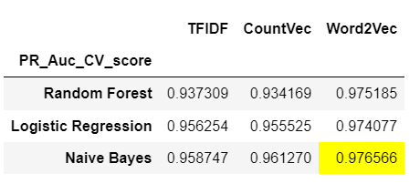
Model Fitting & Selection

Slide 9
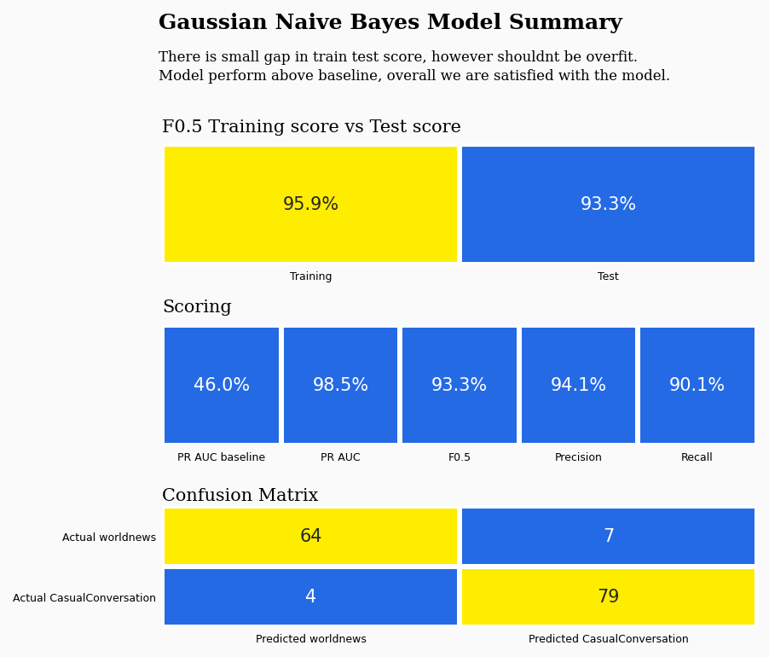
Final Model Performance

Slide 10
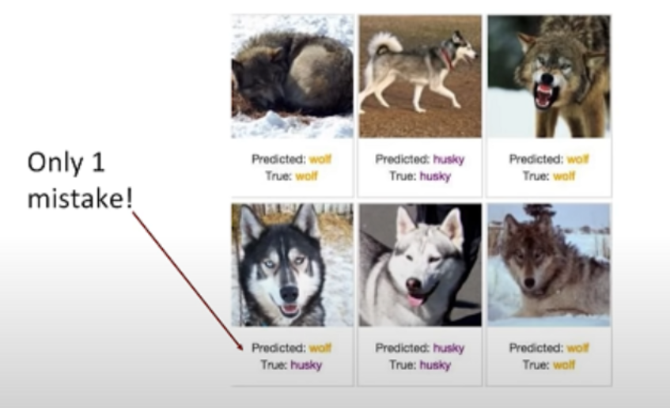
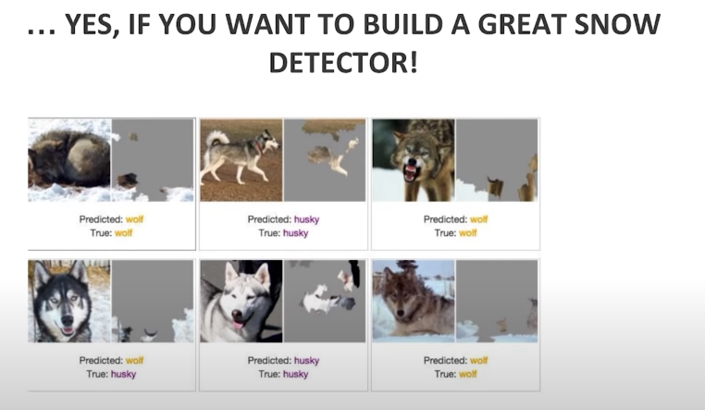
Model Interpretation
Never trust your model based on accuracy.

Slide 11
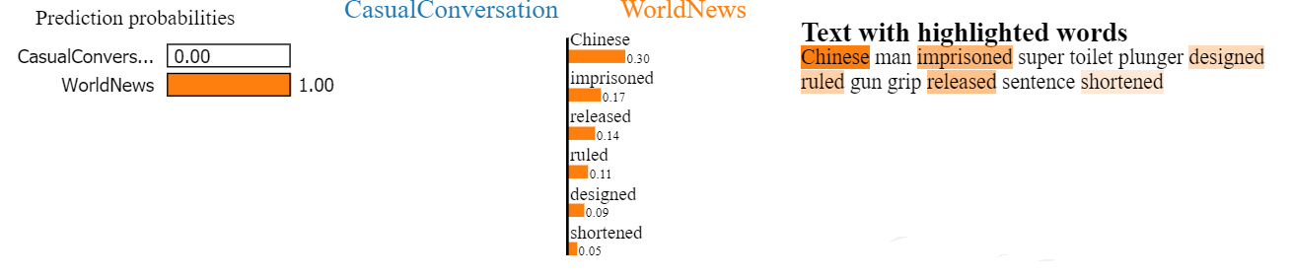
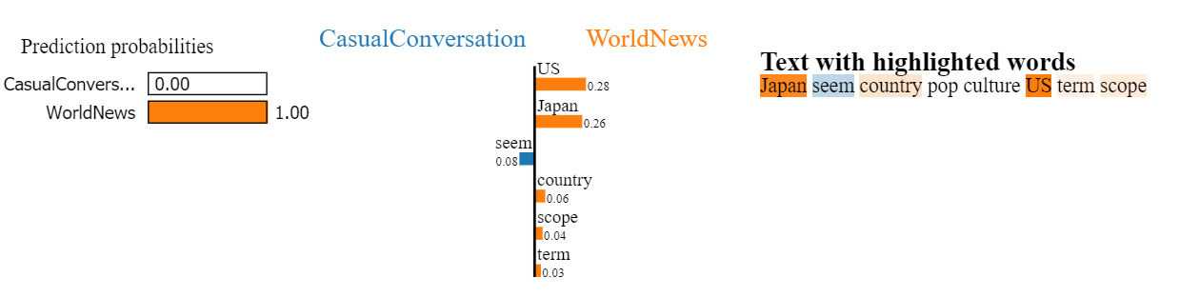
Model Interpretation
Local Interpretable Model-agnostic Explanations (LIME)
True Positive
False Positive
Although predicted wrongly, our model is making sensible prediction as seen in the highlight feature

Slide 12
Conclusion
Best performing model with F-score of 0.93.
Based on the model interpretation, we are confidence that it will generalize.
Future :
Implement Topic modelling Feature to understand the topics of a given text.

Slide 13

Thanks

